Slide 1
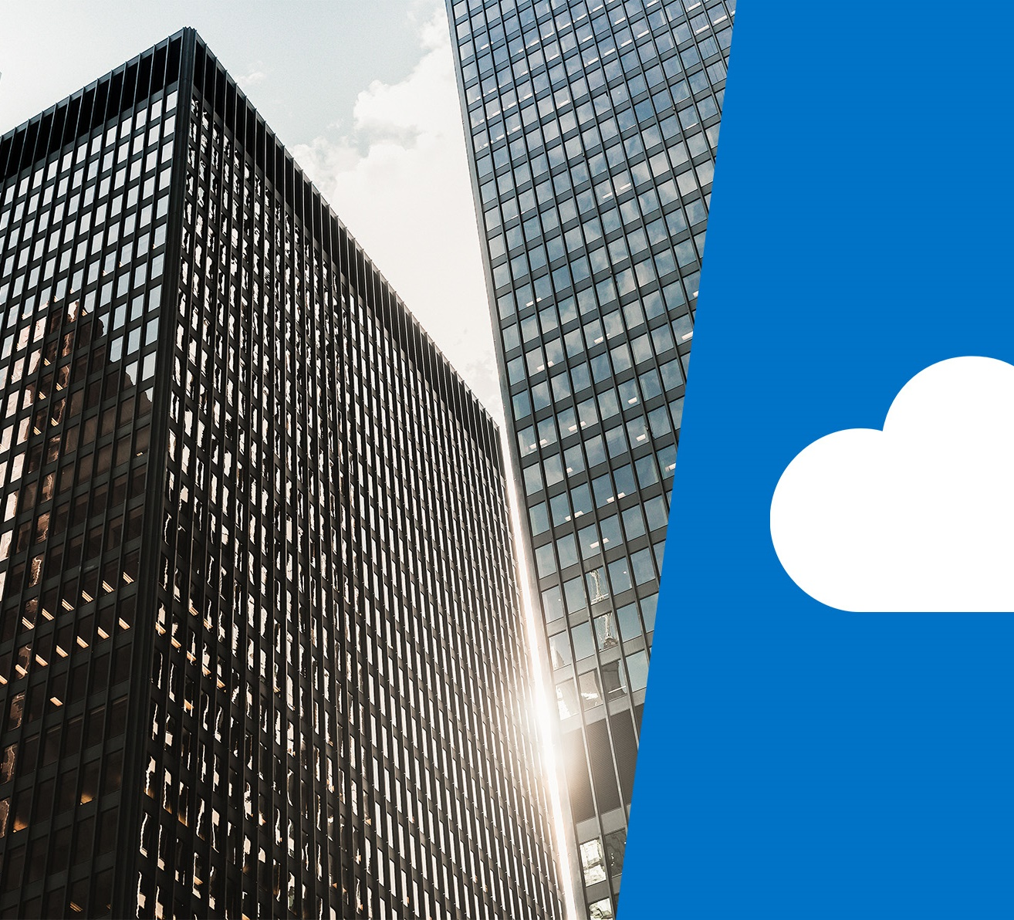
Module 04: Azure pricing and support

Slide 2
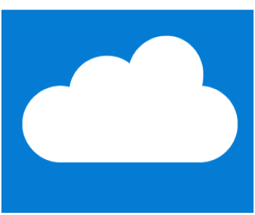
Learning objectives

Slide 3
Module 4 - Content
Understand and describe Microsoft Azure subscriptions and management groups
Recognize ways to plan and manage Azure costs
Identify Azure support options
Understand and describe features of Azure Service Level Agreements (SLAs)
Understand and describe the service lifecycle in Azure

Slide 4
Azure subscriptions

Slide 5
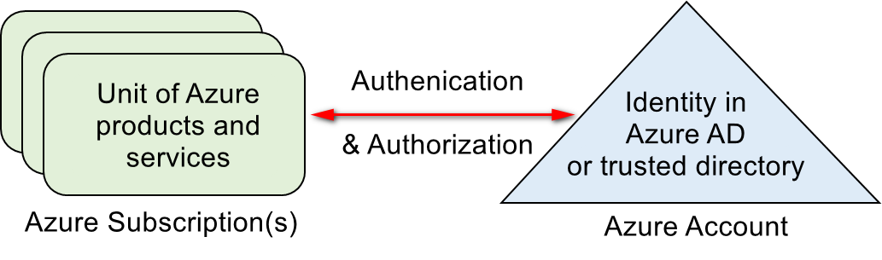
Azure subscriptions
An Azure subscription provides you with authenticated and authorized access to Azure products and services, and allows you to provision resources on Azure. It is a logical unit of Azure services that links to an Azure account.
Azure offers free and paid subscription options to suit different needs and requirements. An account can have one subscription or multiple subscriptions that have different billing models, and to which you apply different access-management policies.

Slide 6
Subscription uses and options
You can use Azure subscriptions to define boundaries around Azure products, services, and resources.
Two types of subscription boundaries that you can use:
Billing boundary. This subscription type determines how an Azure account is billed for using Azure. You can create multiple subscriptions for different types of billing requirements.
Access control boundary. Azure will apply access management policies at the subscription level, and you can create separate subscriptions to reflect different organizational structures.
Several other subscription types to choose from include the Free account, and Pay-As-You-Go.
Notes:
You can select from a range of Azure subscription options, including:
A free subscription. This subscription is for 30 days and includes a $200 credit. This allows you unlimited access to the free Azure products and then a limit of $200 to spend on the paid products. Your Azure services are disabled when the trial ends or when your credit expires for paid products, unless you upgrade to a paid subscription.
Pay-As-You-Go subscription. This subscription allows you to pay for what you use by attaching a credit or debit card to your account. Organizations can apply to Microsoft for invoicing privileges.
Member offers. Your existing membership to certain Microsoft products and services affords you credits for your Azure account and reduced rates on Azure services. For example, member offers are available to Microsoft Visual Studio subscribers, Microsoft Partner Network members, Microsoft BizSpark members, and Microsoft Imagine members.
You could also menti that there are subscription service limits, as per here https://docs.microsoft.com/en-us/azure/azure-subscription-service-limits
For more information on Azure subscription offers, refer to https://azure.microsoft.com/en-us/support/legal/offer-details/

Slide 7
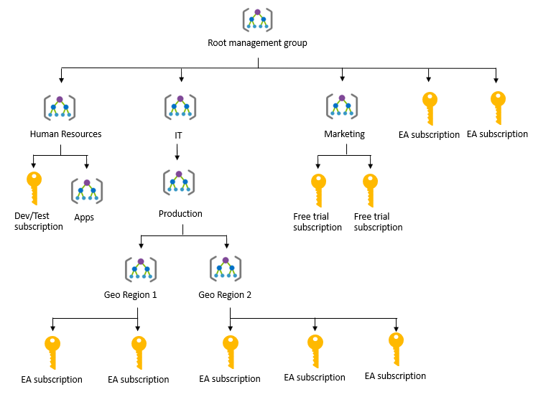
Management groups
Azure Management groups are containers for managing access, policies, and compliance across multiple Azure subscriptions
Management groups allow you to order your Azure resources hierarchically into collections, which provide a further level of classification beyond subscriptions.
Notes:
You can manage your Azure subscriptions more effectively by using Azure Policy and Azure role-based access controls (RBACs). These provide distinct governance conditions that you can apply to each management group. The resources and subscriptions you assign to a management group automatically inherit the conditions that you apply to that management group.
For more information about management groups, refer to:
https://docs.microsoft.com/en-us/azure/governance/management-groups/

Slide 8
Planning and managing costs

Slide 9
Purchasing Azure products and services
Three main customer types on which the available purchasing options for Azure products and services are contingent are:
Enterprise. Enterprise customers sign an Enterprise Agreement with Azure that commits them to spending a negotiated amount on Azure services, which they typically pay annually.
Web direct. Web direct customers sign up for Azure through the Azure website.
Cloud solution providers (CSPs) typically are Microsoft partner companies that a customer hires to build solutions on top of Azure. Payment and billing for Azure usage occurs through the customer's CSP.
Products and services in Azure are arranged by category, such as compute and networking, which have various resources that you can provision.
Notes:
Products and services in Azure are arranged by category, which have various resources that you can provision. You select the Azure products and services that fit your requirements, and your account is billed according to Azure's pay-for-what-you-use model.
Usage meters
When you provision an Azure resource, Azure creates one or more meter instances for that resource. The meters track the resources' usage, and each meter generates a usage record that is used to calculate your bill.
For example, a single virtual machine that you provision in Azure might have the following meters tracking its usage:
Compute Hours
IP Address Hours
Data Transfer In
Data Transfer Out
And more
For more information about purchasing Azure products and services, refer to https://azure.microsoft.com/en-us/pricing/purchase-options/

Slide 10
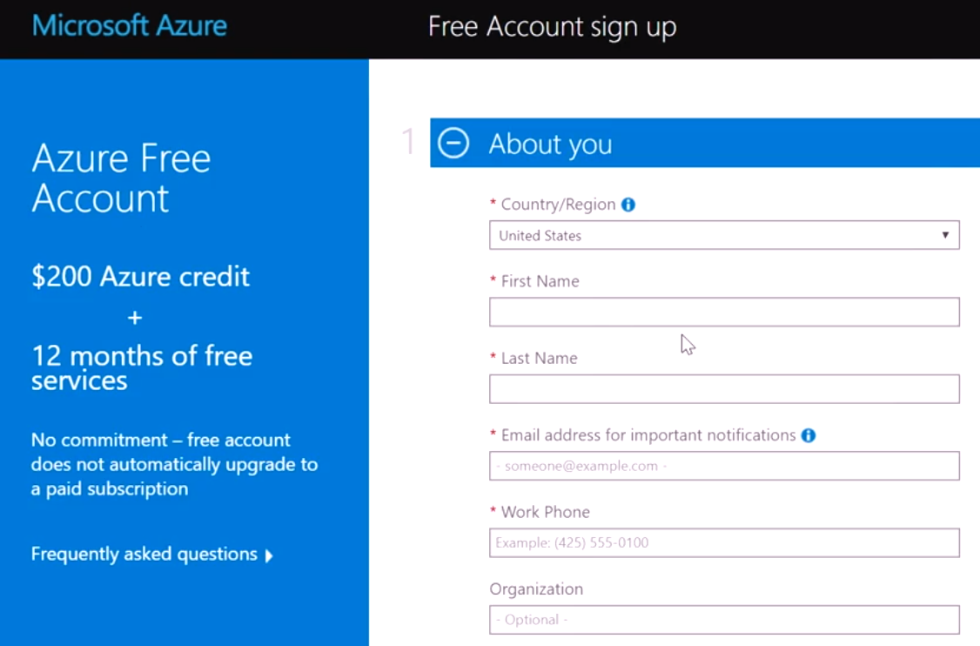
Azure free account
An Azure free account provides subscribers with a $200 Azure credit that they can use for paid Azure products during a 30-day trial period.
Once you use that $200 credit or reach your trial's end, Azure suspends your account unless you sign up for a paid account.
Notes:
If you upgrade to a Pay-As-You-Go subscription within the 30-day trial period, by providing your credit or debit card details you can use a limited selection of free services for 12 months. After 12 months, you will be billed for the services and products in use on your account at the pay-as-you-go rate.
For more information about Azure free accounts, refer to https://azure.microsoft.com/en-us/free/

Slide 11
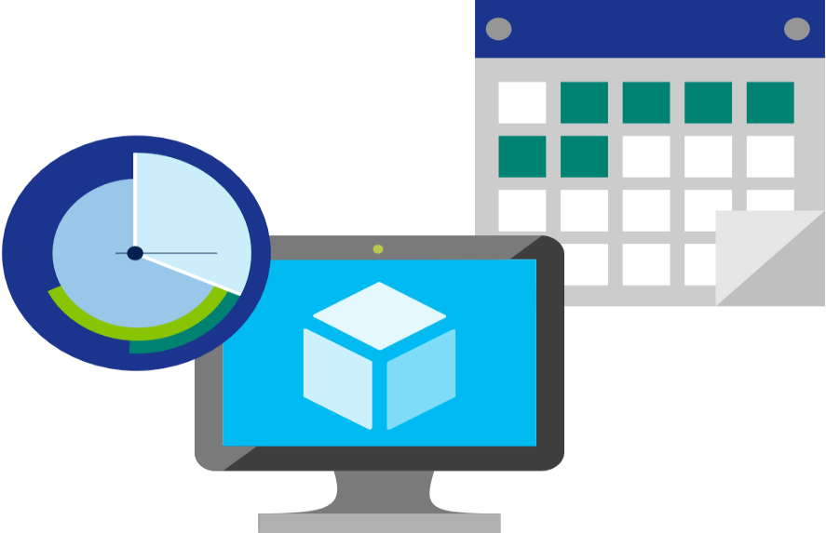
Factors affecting costs
Three factors affect costs:
Resource Type: Costs are resource-specific, so the usage that a meter tracks and the number of meters associated with a resource depend on the resource type.
Services: Azure usage rates and billing periods can differ between Enterprise, Web Direct, and CSP customers.
Location: The Azure infrastructure is globally distributed, and usage costs might vary between locations that offer particular Azure products, services, and resources.
Notes:
For more information about Azure usage charges, refer to https://docs.microsoft.com/en-us/azure/billing/billing-understand-your-invoice

Slide 12

Zones for Billing Purposes
Bandwidth refers to data moving in and out of Azure datacenters. Some inbound data transfers are free, such as data going into Azure datacenters. For outbound data transfers—such as data going out of Azure datacenters—pricing is based on Zones.
A zone is a geographical grouping of Azure Regions for billing purposes. Zones are:
Zone 1. Includes West US, East US, West Europe, and others.
Zone 2 . Includes Australia Central, Japan West, Central India, and others.
Zone 3. Includes Brazil South only.
DE Zone 1. Includes Germany Central and Germany Northeast.
Notes:
Point out that Zone is different from Availability Zone. Availability Zones being and Azure service providing High availability, whereas Zones in the context of billing are geographical entities, used for data transfer pricing between defined geographical areas called Zones.
Zone is a geographical grouping of Azure Regions for billing purpose. Data transfer pricing is based on the Zones.

Slide 13
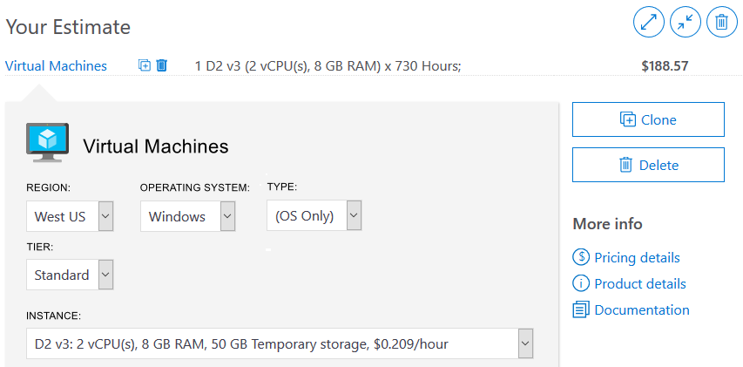
Pricing calculatorcost of Azure products You choose the Azure products
Helps you estimate the you need and configure them according to your specific requirements
Azure provides a detailed estimate of the costs associated with your selections and configurations
Notes:
You might want to demonstrate the Pricing calculator at https://azure.microsoft.com/en-us/pricing/calculator/
Note: The pricing calculator provides estimates, and not actual price quotes. Actual prices can vary depending upon the date of purchase, the payment currency, and the type of Azure customer.
Get a new estimate from the pricing calculator by adding, removing, or reconfiguring selected products. You also can access pricing details, product details, and documentation for each product from the pricing calculator.

Slide 14
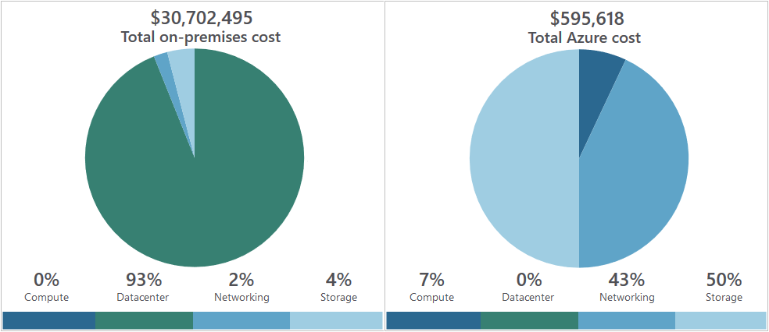
Total cost of ownership (TCO) calculator
A tool that you use to estimate cost savings you can realize by migrating to Azure
A report compares the costs of on-premises infrastructures with the costs of using Azure products and services to host infrastructure in the cloud
Notes:
You might want to demonstrate the TCO calculator at https://azure.microsoft.com/en-us/pricing/tco/calculator/
To use the TCO calculator, complete the following three steps:
1. Define your workloads:
Enter details about your on-premises infrastructure into the TCO calculator according to four groups:
Servers. Enter details of your current on-premises server infrastructure.
Databases. Enter details of your on-premises database infrastructure in the Source section, and select the corresponding Azure service you would like to use in the Destination section.
Storage. Enter the details of your on-premises storage infrastructure.
Networking. Enter the amount of network bandwidth you currently consume in your on-premises environment.
2. Adjust assumptions:
Adjust the values of key assumptions that the TCO calculator makes, which might vary between customers. To improve the accuracy of the TCO calculator, adjust the values so they match the costs of your current on-premises infrastructure:
Storage costs
IT labor costs
Hardware costs
Software costs
Electricity costs
Virtualization costs
Datacenter costs
Networking costs
Database costs
3. View the report.

Slide 15
Minimizing costs
The following best practice guidelines can help minimize your Azure costs:
Perform cost analyses. Use the Azure Pricing and TCO calculators
Monitor usage with Azure Advisor. Implement recommendations
Use spending limits. Use via free trial customers and some credit-based Azure subscriptions
Use Azure Reservations. To get a discount, reserve products and resources by paying in advance. Prepay for 1 or 3 years, and achieve up to 72% savings over pay-as-you-go costs
Choose low-cost locations and regions. If possible, use low-cost locations
Apply tags to identify cost owners. Identify usage owners with tags
Notes:
Perform cost analyses
Plan your Azure solution wisely. Carefully consider the products, services, and resources you need, and read the relevant documentation to understand how each of your choices are metered and billed. Additionally, calculate your projected costs by using the Azure Pricing and Total Cost of Ownership (TCO) calculator, only adding the products, services, and resources you need.
Monitor usage with Azure Advisor
In an efficient architecture, provisioned resources match the demand for those resources. Azure Advisor identifies unused or under-utilized resources, and you can implement its recommendations by removing unused resources and configuring your resources to match your actual demand.
Use spending limits
Free trial customers and some credit-based Azure subscriptions can use spending limits, which Azure provides to help prevent customers from exhausting the credit on their account within each billing period. If you have a credit-based subscription and you reach your configured spending limit, Azure suspends your subscription until a new billing period begins.
The spending limit feature is not available for customers who aren't using credit-based subscriptions, such as Pay-As-You-Go subscribers.
For more information on Azure spending limits, refer to https://docs.microsoft.com/en-us/azure/billing/billing-spending-limit
Note: Azure spending limits are not the same as Subscription, Service, or Resource Group limits and quotas. For more information, refer to https://docs.microsoft.com/en-us/azure/azure-subscription-service-limits
Use Azure Reservations
Azure Reservations offer discounted prices on certain Azure products and resources. To get the discount, reserve products and resources by paying in advance. You can pre-pay for one or three years of use of:
Virtual machine (VM)
SQL Database Compute Capacity
Azure Cosmos Database Throughput
Other Azure resources
Azure Reservations are only available to Microsoft Azure Enterprise or CSP customers, and for Pay-As-You-Go subscriptions.
For more information on Azure Reservations, visit https://docs.microsoft.com/en-us/azure/billing/billing-save-compute-costs-reservations
Choose low-cost locations and regions
The cost of Azure products, services, and resources can vary across locations and regions. Some resources are metered and billed according to how much outgoing network bandwidth they consume (egress). If possible, provision connected resources that are bandwidth metered in the same region to reduce egress traffic between them. Also, If possible, use locations and regions where they cost less.
Research available cost-saving offers
Keep up-to-date with the latest Azure customer and subscription offers, and switch to offers that provide the greatest cost-saving benefit.
Apply tags to identify cost owners
Tags help you manage costs associated with the different groups of Azure products and resources. You can apply tags to groups of Azure products and resources to organize billing data. For example, if you run several virtual machines for different teams, you can use tags to categorize costs by department (such as Human Resources, Marketing, or Finance), or by environment (such as Production or Test). Tags make it easier to identify groups that generate the biggest Azure costs so you can adjust your spending accordingly.

Slide 16
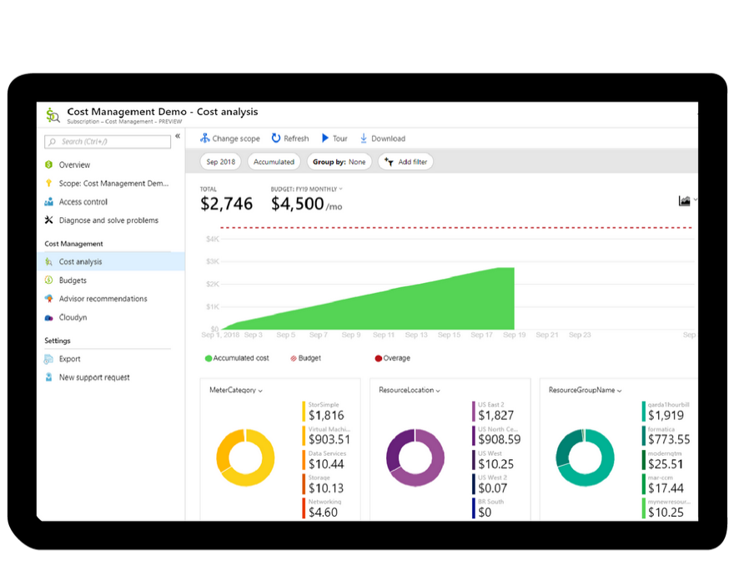
Azure Cost Management
Azure Cost Management is an Azure product that provides a set of tools for monitoring, allocating, and optimizing Azure costs
Reporting. Generate reports
Data enrichment. Improve accountability by categorizing resources with tags
Budgets. Monitor resource demand trends, consumption rates, and cost patterns
Alerting. Get alerts based on your cost and usage budgets
Recommendations. Receive recommendations to eliminate idle resources and to optimize provisioned Azure resources
Notes:
Note: For more information about Cost Management, refer to https://azure.microsoft.com/en-us/services/cost-management/

Slide 17
Support options available with Azure

Slide 18
Support plan options
Every Azure subscription includes:
Free access to billing and subscription support
Azure products and services documentation
Online self-help documentation
Community support forums
Paid Azure support plans:
Developer. For Azure use in trial and nonproduction environments
Standard. Appropriate for Azure use in production environments
Professional Direct. Appropriate for organizations with business-critical dependence on Azure
Premier. Ideal for organizations with substantial dependence on Microsoft products, including Azure.
Notes:
Support plans:
Developer. Developer support is appropriate for Azure use in trial and nonproduction environments. It includes business hours access to support engineers via email, minimum business impact (severity C) incident submission, and less than eight business hours for initial response time.
Standard. Standard support is appropriate for Azure use in production environments. It includes access to support engineers via email and phone 24 hours a day, seven days a week. Critical business impact (severity A) incident submission includes less than one hour initial response time for severity A incidents.
Professional Direct. Professional Direct (ProDirect) is appropriate for organizations with business-critical dependence on Azure. The ProDirect option includes all features of the Standard option, and:
Escalation management for priority issues.
Proactive guidance from a team of ProDirect Delivery Managers.
Onboarding services, service reviews, and Azure Advisor consultations.
Architectural guidance based on best practices.
Azure Engineering-led web seminars.
Premier. Premier support is ideal for organizations with substantial dependence on Microsoft products, including Azure. This solution includes all features of ProDirect, and:
Support assistance for all Microsoft products and services.
Less than 15 minutes initial response time with Azure Rapid Response (requires an additional fee).
Service reviews and reporting delivered by a designated technical account manager.
Customer-specific architectural support such as design reviews, performance tuning, and configuration.
implementation assistance delivered by Azure technical specialists.
Support-plan availability and billing
The support plans you select and how you are billed for support depends on the type of Azure customer you are, and the type of Azure subscription you have. For example, Developer support is not available to Enterprise customers. Instead, Enterprise customers can purchase Standard, Professional Direct, and Premier support plans, and be billed for support as part of an Enterprise Agreement (EA). Conversely, if you purchase a support plan within a pay-as-you-go subscription, your support plan is charged to your monthly Azure subscription bill.
For more information about Azure support options, refer to https://azure.microsoft.com/en-us/support/plans/

Slide 19
Opening a support ticket
Request assistance for an Azure issue from the Azure support team
To open a support ticket:
Sign in to the Azure portal.
Choose Help + support from the left navigation menu.
From the Help + Support blade, select New support request, fill in the required details, and then click Create to submit the support request.
You can also Monitor a support request in the Help + support blade
Notes:
For more information about creating an Azure support ticket, refer to https://docs.microsoft.com/en-us/azure/azure-supportability/how-to-create-azure-support-request
Note: All Azure customers can access billing, quota, and subscription-management support. The availability of support for other issues depends on the support plan you have.

Slide 20
Alternative support channels
Other support channels available outside of the Azure official support plans:
Azure community support.
stack overflow
Azure Feedback Forums at Microsoft Azure general feedback
Twitter. Tweet @AzureSupport to get answers and support
Notes:
For more information about alternative Azure support channels, refer to https://azure.microsoft.com/en-us/support/community/

Slide 21
Knowledge Center
Azure Knowledge Center is a searchable database that contains support questions and answers from a community of Azure experts, developers, customers, and users
Browse through all answers within the Azure Knowledge Center by entering keyword search terms into the text-entry field and further refine your search results by selecting products or tags from the dropdown lists
See Azure Knowledge Center for more information
Notes:
For more information about alternative Knowledge Center, refer to https://azure.microsoft.com/en-us/resources/knowledge-center/

Slide 22
Azure SLAs

Slide 23
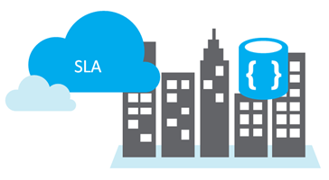
Service Level Agreements (SLAs)
SLAs document the specific terms that define Azure performance standards
SLAs define Microsoft’s commitment to an Azure service or product
Individual SLAs are available for each Azure product and service
SLAs also define what happens if a service or product fails to meet the designated availability commitments

Slide 24
SLAs for Azure products and services
Three key characteristics of SLAs for Azure products and services:
Performance targets, uptime and connectivity guarantees: Uptime or connectivity rates, such as availability
Performance targets range: Typical SLAs specify performance-target commitments ranging from 99.9 percent (three nines) to 99.99 percent (four nines)
Service credits: Percentage of the applicable monthly service fees credited to you if a service fails to meet ALS uptime guarantee
For more information about specific Azure SLAs for individual products and services, see Service Level Agreements
Notes:
Performance Targets, Uptime and Connectivity Guarantees
An SLA defines performance targets for an Azure products and services.
Performance targets range from 99.9 percent to 99.99 percent
A typical SLA specifics performance-target commitments that range from 99.9 percent (three nines) to 99.99 percent (four nines).
Service Credits
SLAs also describe how Microsoft will respond if an Azure product or service fails to perform to its governing SLA's specification. For example, customers could have a discount applied to their Azure bill as compensation for an under-performing Azure product or service. An example is in the table below for single instance Azure VMs where if the monthly uptime percentage is less than the specified value, you receive the corresponding service credit, or discount.
| MONTHLY UPTIME PERCENTAGE | SERVICE CREDIT |
| --- | --- |
| < 99.9% |10% |
| < 99% |25% |
| < 95% |100% |
Note: For a lot of Azure services, no SLA is provided for services under either the Free or Shared tiers. Also, Free products such as Azure Advisor do not typically have an SLA.
You might want to browse to some SLA’s directly https://azure.microsoft.com/en-us/support/legal/sla/summary/ and explore one or two as examples.

Slide 25
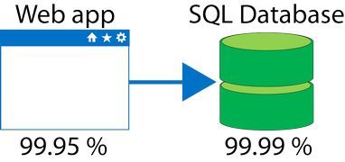
Composite SLAs
At the time of this writing, an App Service web app that writes to Azure SQL Database has the following SLAs:
App Service Web Apps is 99.95 percent
SQL Database is 99.99 percent
Question: What is the maximum downtime you would expect for this application?
Answer: The composite SLA for this application is 99.95% × 99.99% = 99.94%.
This is lower than the individual SLAs. However, you can construct SLAs to improve overall application SLA.

Slide 26
Improving application SLAs
Azure customers can use SLAs to evaluate how their Azure solutions meet their business requirements, and the needs of their clients and users. By creating their own SLAs, organizations can set performance targets to suit their specific Azure application. This is known as an application SLA.
Considerations for defining application SLAs:
Self Healing: Your Azure solution should be self-diagnosing and self-healing
Response Time: Responding to failures quickly enough to meet SLA performance targets above four 9’s are difficult to meet
Realistically Achievable: The smaller the time window for recovery (for example, hourly or daily) the tighter the tolerances and higher the cost
Notes:
You could also discuss about the following topics if you have time.
Resiliency
Resiliency is the ability of a system to recover from failures and continue to function. It's not about avoiding failures but responding to failures in a way that avoids downtime or data loss. The goal of resiliency is to return the application to a fully functioning state following a failure. High availability and disaster recovery are two important components of resiliency.
Cost and complexity vs. high availability
Availability refers to time that a system is functional and working. Maximizing availability requires implementing measures to prevent possible service failures. However, devising preventative measures can be difficult and expensive, and often results in very complex solutions.
For more information about improving application SLAs, refer to https://docs.microsoft.com/en-us/azure/architecture/resiliency/

Slide 27
Improving application SLAs - continued
The following table lists the potential cumulative downtime for various SLA levels over different durations
SLA | Downtime per week | Downtime per month | Downtime per year
99% | 1.68 hours | 7.2 hours | 3.65 days
99.9% | 10.1 minutes | 43.2 minutes | 8.76 hours
99.95% | 5 minutes | 21.6 minutes | 4.38 hours
99.99% | 1.01 minutes | 4.32 minutes | 52.56 minutes
99.999% | 6 seconds | 25.9 seconds | 5.26 minutes

Slide 28
Service lifecycle in Azure

Slide 29
Public and private preview features
Microsoft offer previews of Azure features for evaluation purposes.
With Azure previews, you can test beta and other pre-release features, products, services, software, and regions.
Two types of Azure preview modes:
Private Preview. An Azure feature is available to certain Azure customers for evaluation purposes
Public Preview. An Azure feature is available to all Azure customers for evaluation purposes
Notes:
Some preview features are not covered by customer support.
For more information about Azure Previews, visit https://azure.microsoft.com/en-us/services/preview/

Slide 30
How to access preview features
Review a list of preview features that are available for evaluation at Azure Preview Features
To preview a feature, select the Try it button for the applicable feature
Portal Preview features:
Access preview features that are specific to the Azure Portal from the Portal Preview Features page.
Typical portal preview features provide performance, navigation, and accessibility improvements to the Azure portal interface
Notes:
Together, these experiences provide you with a comprehensive view into the health of Azure at the granularity that is most relevant to you.
For more information about Azure Service Health Visit https://docs.microsoft.com/en-us/azure/azure-monitor/overview

Slide 31
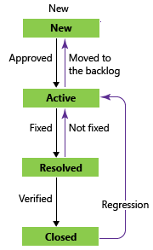
General Availability
Once a feature is evaluated and tested successfully, it might be released to customers as part of Azure's default product, service, or feature set
Bugs for features and products go through their lifecycle as in the graphic across.
Once the feature meets a specific criteria the feature is released to all Azure customers, and this release is referred to general availability.

Slide 32
Monitoring feature updates
Information about the latest updates to Azure products, services, and features, and product roadmaps, and announcements are available at Azure updates
Azure updates page:
View details about all Azure updates
See which updates are in general availability, preview, or development
Subscribe to Azure update notifications by RSS
Notes:
From the Azure updates page, you can:
View details about all Azure updates.
See which updates are in general availability, preview, or development.
Browse updates by product category or update type by using the provided dropdown lists.
Search for updates by keyword by entering search terms into a text-entry field.
Subscribe to get Azure update notifications by RSS.
Access the Microsoft Connect page to read Azure product news and announcements.
For more information about Azure updates, refer to https://azure.microsoft.com/en-us/updates/

Slide 33
Quiz

Slide 34


